Slide 1
HRM PRESENTATION
Importance of HR

Slide 2


K191048 (Amman Soomro)
Group Members
K191118 (Naba Jafri)
K191042 (Abdullah Ansari)

Slide 3
“WHY SHOULD WE HIRE YOU?” because y’all hiring tf, don’t you all need some help?

Slide 4

First Things First
Appreciate you HR managers

Slide 5

Not so easy job

Slide 6


Surrounded by idiots

Slide 7
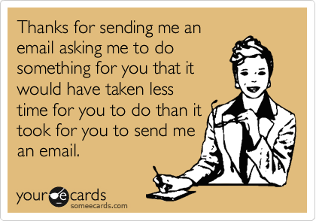
Higher Authorities exploiting you

Slide 8

NOT PAID WELL

Slide 9

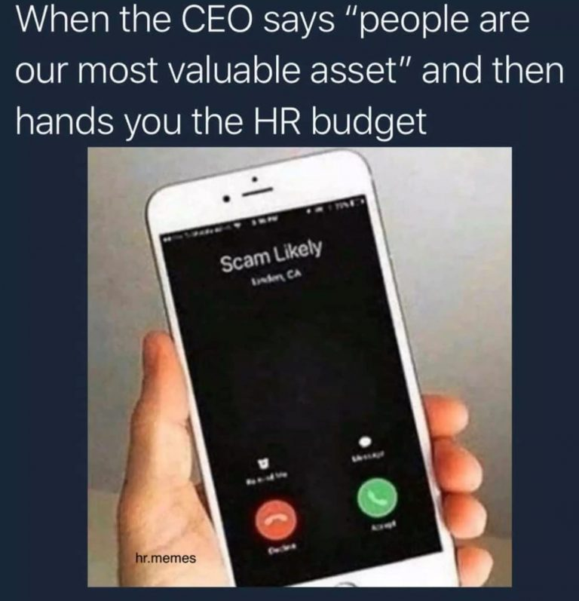
MAKING UP FOR LOOSE ENDS

